Slide 1


Intermountain Project ECHO TeleCritical Care Medicine Recent Evidence on the Management of Acute Pancreatitis
Notebook of references
Brian Locke, MD MSCI
Assistant Professor of Research
Pulmonary and Critical Care
Intermountain Medical Center
COI: Equity Interest MTN Biometrics

Slide 2
Learning Objectives
Compare fluid-shift mechanisms in acute pancreatitis vs sepsis
Explain the relevance of hematocrit for guiding resuscitation.
Use recent trial data to estimate a usual fluid resuscitation strategy
Diagnose non-gallstone pancreatitis, gallstone pancreatitis without cholangitis and gallstone pancreatitis with cholangitis and recognize the management implications.
Evaluate when pancreatic fluid collections ought to be drained and when antibiotics should be started.
Explain when enteral nutrition should be started, and for what purpose.
Notes:
Why worthwhile for teleCC?
sometimes, referral capabilities needed (e.g. ERCP, etc.)
adherence to best practices is low: MANCTRA‑1 international audit (2022) shows poor compliance with evidence‑based management of biliary AP, e.g., variable use of early feeding, ERCP timing, and cholecystectomy.

Slide 3
Case 1: 45 M with EtOH use disorder presents with pancreatitis
MAP 75, HR 115, room air. 70kg
WBC: 16, Hgb 16.5, Plt 550
BMP: 135 / 3.2 / 99 / 16 / 50 / 1.5
Lipase: 5000, Lactate 3
AST/ALT 300/150, Bili 2
How much fluid do you order?
a.) a bolus of a 1-2L, then 100/hr LR
b.) a bolus of 2-4L, then 200/hr LR
C.) a bolus of 4-6L, then 300/hr LR
d.) no bolus, 150/hr LR

Slide 4
Pancreatitis vs. Sepsis
Compare and Contrast
Pancreatitis
Physiology: endothelial injury, substantial 3rd spacing to perit.
Symptoms: N/V/Pain, impaired intake
Manifestation: hemoconcentration
Consequence: Impaired perfusion to pancreas -> necrosis
Sepsis
Physiology: vasodilation, low stressed volume -> impaired venous return.
Symptoms: variable by site.
Manifestation: no hemoconcentration
Consequence: global hypotension and organ dysfunction.
Notes:
Patients presenting with AP are also hypovolemic due to vomiting, reduced oral intake, increased respiratory losses, and diaphoresis

Slide 5
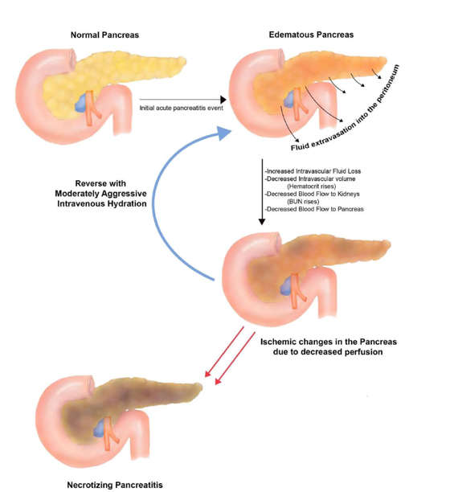
Method:
For aggressive fluid resuscitation in A.P.
Goal: restore perfusion to the pancreas to avoid subsequent necrosis (rather than maintain MAP)
Follow HCT (& BUN) – 6-hr and 24-hr recheck.
If HCT rising or above baseline – more fluid.
BUN functions similarly (but reflects renal function)
Goal: restore perfusion fast -> first 6 hours (maybe 24h) matter
beyond that, not so much.
2024 ACG Acute Pancreatitis Guideline
Notes:
Fluid resuscitation in patients with AP is likely more important early in the course of the disease (within the first 24 hours).
Fluid volumes need to be reassessed at frequent intervals within 6 hours of presentation and for the next 24–48 hours with a goal to decrease the BUN.
-> Patients with AP have marked systemic endothelial injury and increased vascular permeability leading to fluid shifts into the interstitial space and peritoneum
(in a way that patients with Sepsis generally don’t)
Vasospasm captured by CT -> Pancreatic Ischemia -> Necrosis
https://journals.lww.com/pancreasjournal/abstract/2005/01000/pancreatic_ischemia_associated_with_vasospasm_in.6.aspx
https://journals.lww.com/pancreasjournal/abstract/2000/05000/hemoconcentration_is_an_early_marker_for_organ.5.aspx – hemoconcentration is a marker of sepsis
111. Garg PK, Mahapatra SJ. Optimum fluid therapy in acute pancreatitis needs an alchemist. Gastroenterology 2021;160(3):655–9.
Order HCT / BUN 6-8 hours to assess adequacy / kinetics
BUN-HCT kinetics… but what do you do with that?

Slide 6
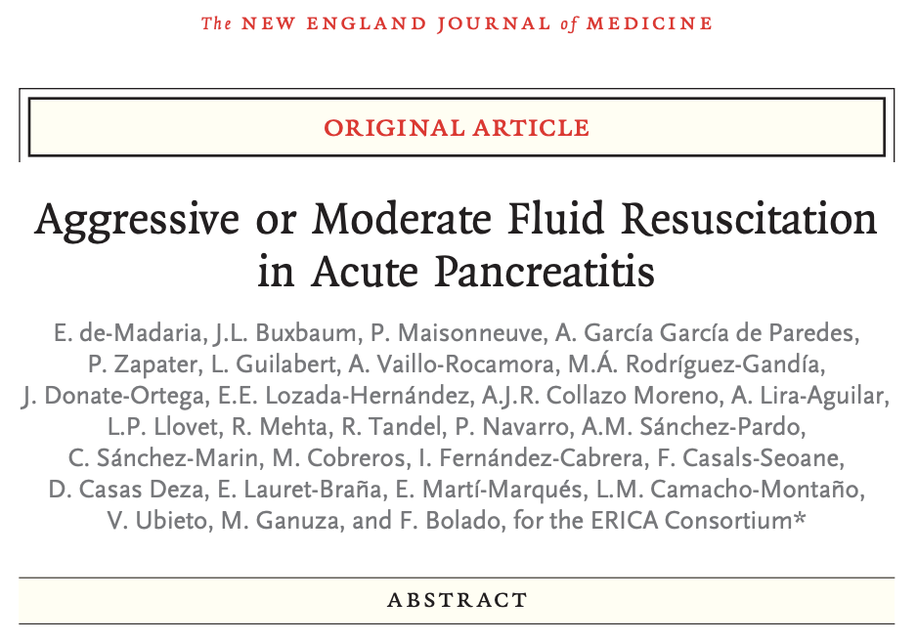
Trial 1: Fluids
WATERFALL Trial
NEJM 2022
Notes:
Aggressive vs moderate fluid resuscitation
• Key RCT: WATERFALL (NEJM 2022) – early aggressive LR (20 mL/kg bolus + 3 mL/kg/h) vs moderate strategy (no bolus, 1.5 mL/kg/h, titrated). Aggressive strategy led to more fluid overload without improving progression to moderately severe/severe AP or other hard outcomes.

Slide 7
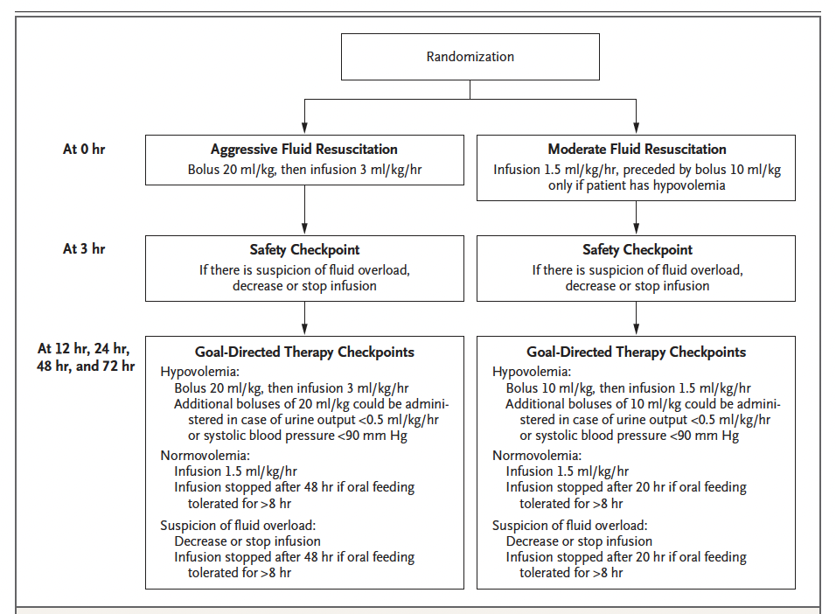
WATERFALL TRIAL
NEJM 2022: RCT, 18 centers, 249 patients
India, Italy, Mexico, and Spain
Inclusion: AP, w/n 24h of pain onset and 8h of diagnosis.
Exclusion: already mod-severe disease
Outcome: New Mod-Sev dz (local complication, sCr 1.9+, hypotension, hypoxemia)
WATERFALL Trial, NEJM 2022
Notes:
local complications,
exacerbation of a preexisting coexisting
condition, a creatinine level of at least 1.9 mg
per deciliter (170 μmol per liter), a systolic blood
pressure of less than 90 mm Hg despite fluid
resuscitation, and a ratio of t
The main safety outcome — fluid overload
after randomization and during hospitalization
— required the meeting of at least two of the
following three criteria: symptoms, physical
signs, and imaging evidence of hypervolemia; in
addition, the acute respiratory distress syndrome
had to be ruled out (

Slide 8
WATERFALL TRIAL
Stopped @ 1/3 expected n for safety
Aggressive Fluid (LR) Resus.
7.8L in 24h [IQR 6.5 – 9.8]
1: 22.1% got moderately severe or severe pancreatitis
20.5% of patients with fluid overload (2 of sympt, signs, imaging evidence of overload)
RR 2.85 (95% CI, 1.36 to 5.94)
Moderate Fluid (LR) Resus.
5.5L in 24h [IQR 4.0 to 6.8]
1: 17.3% got moderately severe or severe pancreatitis
6.3% of patients with fluid overload

Slide 9
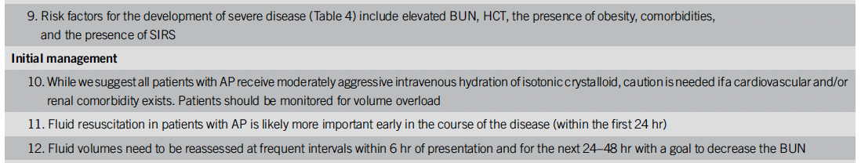
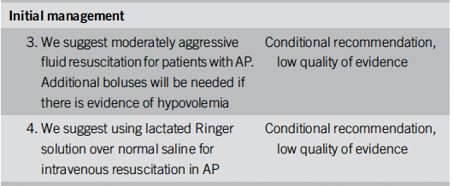
2024 ACG Guidelines say:
Moderate fluid resuscitation
More important early (6h)
Reassess (q6 initially)
Notes:
• SRMAs & follow‑up observational data now generally agree that aggressive “flooding” increases AKI and pulmonary edema and is unlikely to improve survival.
• Practice‑change angle (very likely correct, high‑quality evidence): move from “aggressive by default” to moderate, goal‑directed resuscitation (with frequent reassessment, especially in older, obese, or cardiac patients).

Slide 10
Case 1: 45 M with EtOH use disorder presents with pancreatitis
MAP 75, HR 115, room air. 70kg
WBC: 16, Hgb 16.5, Plt 550
BMP: 135 / 3.2 / 99 / 16 / 50 / 1.5
Lipase: 5000, Lactate 3
AST/ALT 300/150, Bili 2
How much fluid do you order?
a.) a bolus of a 1-2L, then 100/hr LR
b.) a bolus of 2-4L, then 200/hr LR
C.) a bolus of 4-6L, then 300/hr LR
d.) no bolus, 150/hr LR

Slide 11
Case 2: 45 F with recent weight loss presents with pancreatitis
MAP 70, HR 130, room air. 70kg
WBC: 20, Hgb 16.5, Plt 550
BMP: 135 / 3.2 / 99 / 16 / 50 / 3
Lipase: 5000, Lactate 7. T 37.2
AST/ALT 300/700, Bili 4
Does this patient need a transfer?
a.) no, supportive care for severe biliary AP
b.) yes, needs immediate ERCP
c.) yes, needs immediate MRCP
d.) yes, will need cholecystectomy anyway.

Slide 12
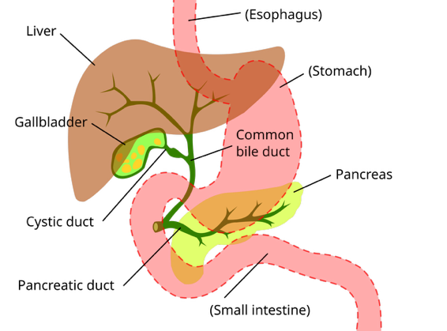
Rationale
Terms
Microlithasis [small stones] and sludge [viscous gall fluid] are common causes of pancreatitis by obstructing the distal common bile duct
Cystic duct + common hepatic => Common bile duct
Common bile duct + Pancreatic duct => (distal) CBD
Choledocholithiasis [persistent CBD stone]
(Ascending) Cholangitis [biliary duct infection]
Wikipedia, “Bile Duct”
Notes:
ACG Guideline: The pathophysiology of gallstone pancreatitis involves the obstruction of the pancreatic duct by a gallstone that passes from the bile duct into the common channel as it opens into the duodenum.Apersistent CBD stone (choledocholithiasis) can lead to persistent pancreatic duct and/or biliary tree obstruction, leading to necrosis and/or cholangitis (129). Although intuitively, removal of obstructing gallstones from the biliary tree in patients with AP should reduce the complications, most gallstones readily pass to the duodenum and are lost in the stool (130).
Most patients with gallstone pancreatitis will not benefit from ERCP, including early ERCP.
Schepers et al (¹³¹) performed a multicenter trial to determine whether patients with gallstone pancreatitis and predicted severe AP (APACHE >8, Imrie >3, or C-reactive protein >150 mg/dL) would benefit from early (within 24 hours) ERCP. Early ERCP was not found to decrease complications, including mortality in these patients. Yet, patients who underwent urgent ERCP were less likely to be readmitted for subsequent AP or cholangitis. The authors concluded that urgent ERCP is indicated in this situation only for cholangitis or progressive cholestasis defined by a rising bilirubin in the setting of severe or moderately severe AP (bilirubin >3–5 mg/dL).
Gallstone pancreatitis was defined by either biliary sludge
or gallstones on imaging, a dilated common bile duct on
imaging (>8 mm in patients aged ≤75 years or >10 mm in
patients aged >75 years), or an alanine aminotransferase
concentration of more than twice the upper limit
of normal.
[ ] find diagram
[ ] recall differentiating rules

Slide 13
Rationale
For early ERCP
How do you differentiate gallstone vs non-gallstone pancreatitis?
ALT > ~3x ULN (95% PPV). Lower ALT does NOT rule out (50% spec)
OR visualization of stone or dilated CBD (& no other etio). MRCP = gold.
How do you differentiate gallstone pancreatitis associated with cholangitis and without.
Fever & either direct visualization of a CBD stone (US, MRCP, EUS) or evidence of its presence (dilated CBD, progressive cholestasis)
Establishing when a transient obstruction vs persistent stone is present is hard, and maybe it’s best to just make sure the drainage is relieved?
Notes:
Gallstone pancreatitis was defined by either biliary sludge
or gallstones on imaging, a dilated common bile duct on
imaging (>8 mm in patients aged ≤75 years or >10 mm in
patients aged >75 years), or an alanine aminotransferase
concentration of more than twice the upper limit
of normal.
Cholangitis was defined as fever in combination
with either common bile duct stones, a dilated common
bile duct, or (progressive) cholestasis
‘
Schepers et al (¹³¹) performed a multicenter trial to determine whether patients with gallstone pancreatitis and predicted severe AP (APACHE >8, Imrie >3, or C-reactive protein >150 mg/dL) would benefit from early (within 24 hours) ERCP. Early ERCP was not found to decrease complications, including mortality in these patients. Yet, patients who underwent urgent ERCP were less likely to be readmitted for subsequent AP or cholangitis. The authors concluded that urgent ERCP is indicated in this situation only for cholangitis or progressive cholestasis defined by a rising bilirubin in the setting of severe or moderately severe AP (bilirubin >3–5 mg/dL).

Slide 14
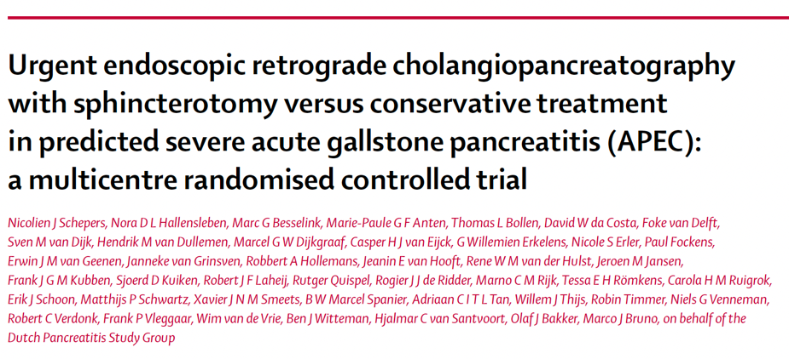
Trial 2: ERCP
APEC Trial
Lancet 2020

Slide 15
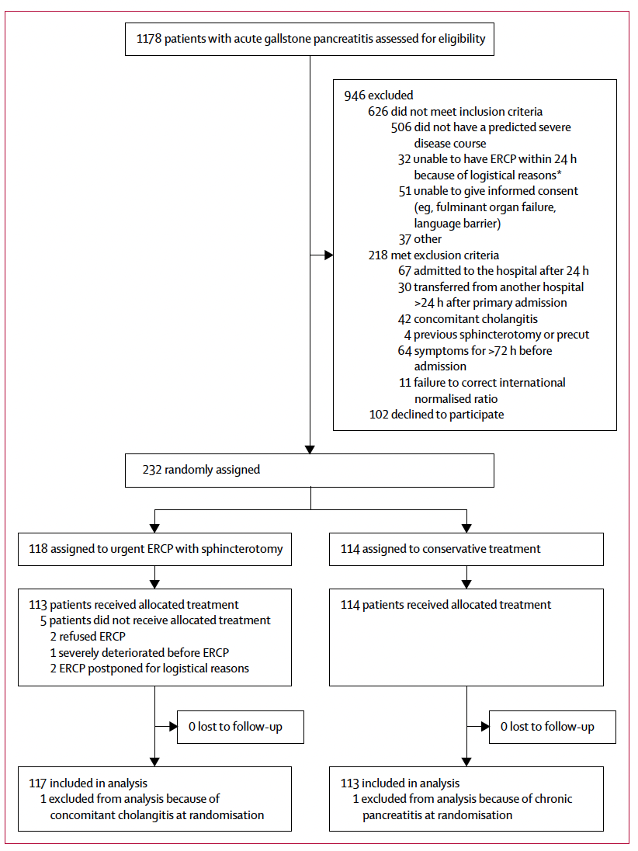
APEC TRIAL
Lancet 2020: RCT, 26 centers, n= 232
Inclusion: gallstone pancreatitis and predicted severe dz (APACHE > 8, Imrie > 3, or CRP>150 mg/dL)
Exclusion: 24+ hrs in, cholangitis = fever + (CBD stone, dil CBD, progressive cholestasis)
Outcome: 6 mo. mortality or major complication (organ failure, necrosis, bacteremia, cholangitis, Pna, or exocrine insufficiency)
APEC Trial, Lancet 2020
Notes:
ERCP. Early ERCP
was not found to decrease complications, including mortality in
these patients. Yet, patients who underwent urgent ERCP were
less likely to be readmitted for subsequent AP or cholangitis

Slide 16
APEC TRIAL
Outcomes
Early (24h from hosp, 72h from symptom) ERCP & sphincterotomy
1: 38%
0.87 (0.64–1.18), P=.37
Cholangitis: 2%
Recurrent Biliary Panc: 0
ICU admission: 21%
Std, w/ ERCP & sphincterotomy if cholangitis developed. [=31%]
1: 44%
Cholangitis: 10% (P = 0.01)
Recurrent Biliary Panc: 9% (P = .001)
ICU admission: 12% (P = .06)
Notes:
The authors concluded that urgent ERCP is indicated in this situation only for cholangitis or progressive cholestasis defined by a rising bilirubin in the setting of severe or moderately severe AP (bilirubin.3–5 mg/dL).
Intensive Care Unit (ICU) Admission: The urgent ERCP group had a tendency toward more ICU admissions (21% vs. 12%; RR 1.78; p=0.063)
cholestasis was defined broadly as a serum bilirubin of more than 2.3 mg/dL (40 μmol/L) or a dilated common bile duct (>8 mm in patients ≤75 years or >10 mm in patients >75 years)

Slide 17
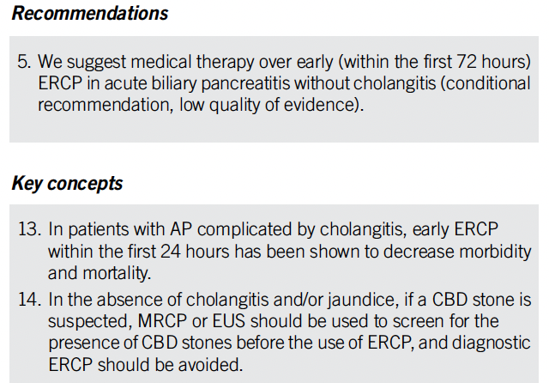
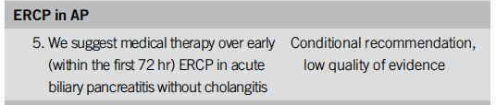
Guidelines say:
only when there’s cholangitis or clear persistent biliary obstruction (bili ≥ 3-5)
not just “severe” biliary AP – many transient.
Notes:
• Good tele‑ICU use‑case: when to push for transfer for ERCP vs local supportive care + EUS/ERCP later.
Practice‑change strength:
• Very likely: Urgent ERCP only for cholangitis/obstruction, not merely high Ranson/BISAP.
—> ie make the point that it’s the folks with cholangitis that need ERCP, not just severe gallstone pancreatitis

Slide 18
Case 2: 45 F with recent weight loss presents with pancreatitis
MAP 70, HR 130, room air. 70kg
WBC: 20, Hgb 16.5, Plt 550
BMP: 135 / 3.2 / 99 / 16 / 50 / 3
Lipase: 5000, Lactate 7. T 37.2
AST/ALT 300/700, Bili 4
Does this patient need a transfer?
a.) no, supportive care for severe biliary AP
b.) yes, needs immediate ERCP
c.) yes, needs immediate MRCP
d.) yes, will need cholecystectomy anyway.
Notes:
Most surgeons will delay when severe for a few weeks – the evidence is around mild pancreatitis.

Slide 19
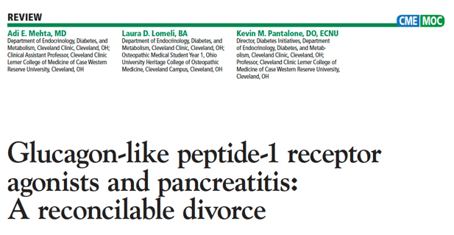
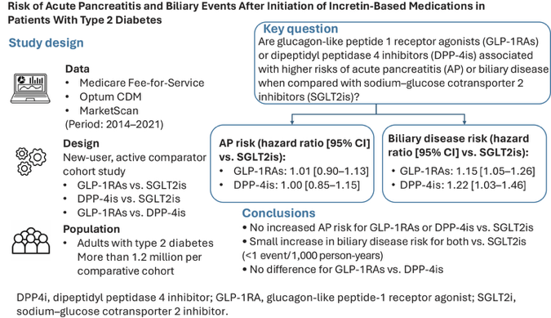
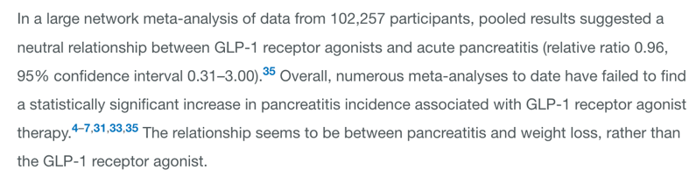
GLP-1 RA (probably) do not cause pancreatitis
Fang et al. Diabetes Care 2025
Notes:
https://diabetesjournals.org/care/article-abstract/48/12/2127/163686/Risk-of-Acute-Pancreatitis-and-Biliary-Events
They are very slightly associated with extra biliary disease, amounting to <1 case per 1,000 person-years.
At least 1 more recent meta-analysis does show a small (~1.4) association.
-
Miscellaneous stuff:
Splanchnic Venous Thrombosis? Do you anticoagulate? Not clear tbh
HyperTG panc -> probably just insulin (no compelling evidence that plasmapheresis is worth the hassle.
C. Timing of cholecystectomy in biliary AP
• Not new RCTs in last 5 years, but you could briefly mention that guidelines still support index admission cholecystectomy for mild disease and delayed surgery in moderately severe/severe disease. (In mild AP - randomized trial describing 998 patients who were discharged rather than undergo cholecystectomy compared with early cholecystectomy, 95 (18%) were readmitted for recurrent biliary events (18% vs 0%, P < 0.0001),)
Old data: • Analgesia strategies – data on patient‑controlled opioids, multimodal analgesia, and epidurals in AP (mostly older trials, but you can briefly note that no strong new RCT in last 5 yrs has changed practice).

Slide 20
Case 3: 45 F is 14 days into severe AP. Fevers and abd pain worsen
MAP 80, HR 110, room air. 60kg
WBC: 20, Hgb 16.5, Plt 550
BMP: 135 / 3.2 / 99 / 16 / 50 / 1.5
T 38.5C
CT A/P: Necrosis, Peri-panc fluid collection with gas. Next move(s)?
a.) antibiotics
b.) antifungals
C.) fine-needle aspiration
d.) surgery
e.) endoscopic drainage

Slide 21
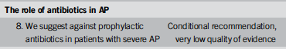
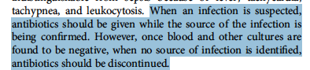
Early antibiotics
Would it prevent this?
Infectious complications drive mortality; patients with infections fair badly.
“There have been 11 prospective randomized trials of evaluating the use of prophylactic antibiotics in severe AP, with rigorous study design, participants, and outcome measures since 1993. Similarly, there were 10 meta-analyses reported since 2006 describing the abovementioned RCT”
“Subsequent better-designed trials have consistently failed to show a benefit in preventing infectious complications in patients with sterile necrosis, compared to earlier, often unblinded, trials that suggested a benefit”
Notes:
Prophylactic Antibiotics? No convincing evidence for it - but diagnosing when a necrotic section is infected is hard.

Slide 22
Pancreatic Necrosis
Infected or not? (Quotes from ACG Guideline)
Infected pancreatic necrosis has a higher mortality rate (mean 30%, range 14%–69%)
Although early unblinded trials suggested a benefit in providing antibiotics to patients with sterile necrosis by preventing infectious complications subsequent better-designed trials have consistently failed to show a benefit
Because patients with infected necrosis and sterile necrosis may appear similar with leukocytosis and fever and organ failure (67,68) it is [often] impossible to separate these entities without CT-FNA

Slide 23
Guidelines
CT-FNA
Get a Fine Needle Aspirate if:
The decision about antibiotics hinges on the result
It would influence whether to do a procedure or timing
Don’t get a Fine Needle Aspirate if:
Nec Panc in the setting of blood stream infection (likely seeded)
Gas on imagine (likely infected)
Unstable warranting intervention

Slide 24
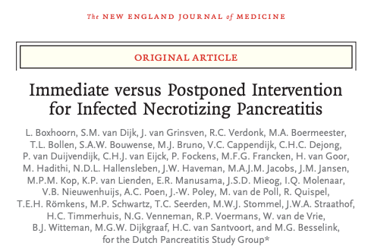
Trial 3: Drainage
POINTER Trial
NEJM 2021

Slide 25
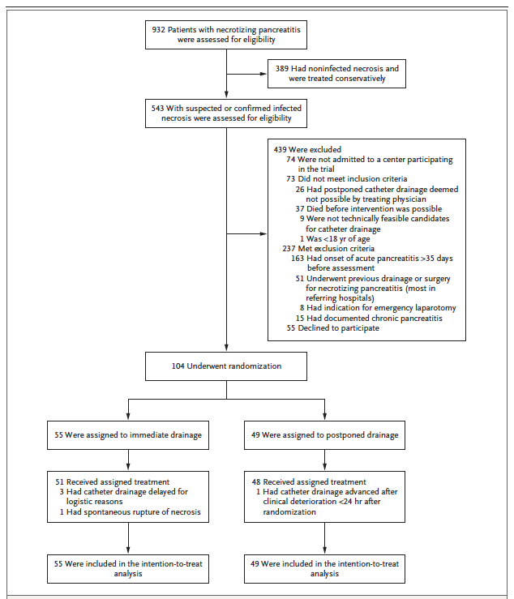
APEC TRIAL
NEJM 2021: 22 centers, n= 104
Inclusion: infected peripancreatic and pancreatic necrosis by FNA or CTgas. eligible for endoscopic / percutaneous drainage. Onset of AP w/n 35d
Exclusion: prior intervention
Outcome: Complications up to 6 mo. [weighted by severity; new organ failure, bleeding, perforation, fistula, exocrine insufficiency.)
POINTER Trial, NEJM 2021
Notes:
ERCP. Early ERCP
was not found to decrease complications, including mortality in
these patients. Yet, patients who underwent urgent ERCP were
less likely to be readmitted for subsequent AP or cholangitis

Slide 26
POINTER TRIAL
Outcomes
Immediate Drainage [mean day 24]
Comprehensive Complication Index [CCI] of 57
Mortality 13%
LOS 59 days(!!)
4.4 mean interventions
Postponed drainage [mean day 34]
CCI of 58 (P=.90)
Mortality 10% (RR 0.42-3.68)
LOS 51 days (!!)
2.6 mean interventions (diff 1.8, 0.6-3.0), 39% no intervention.
Notes:
TIMING Trial (2025) - early vs late drainage of acute necrotic collection.
Drainage:
https://link.springer.com/article/10.1007/s00134-025-08020-x?utm_source=springer_etoc&utm_medium=email&utm_campaign=CONR_00134_AWA1_GL_DTEC_054CI_TOC-090825&utm_content=etoc_springer_20250809
Compared with standard care, early percutaneous drainage did not result in improved clinical outcomes in patients with necrotizing pancreatitis and early persistent organ failure. Current guideline recommendations for delayed intervention should be followed in this population to avoid harm.

Slide 27
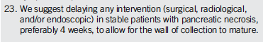
Guidelines
Abx + Drainage
While antibiotics should not be used in patients with sterile necrosis, antibiotics are an important part of treatment in infected necrosis along with debridement/necrosectomy.
In patients with infected necrosis, antibiotics known to penetrate pancreatic necrosis should be used largely to delay surgical, endoscopic, and radiologic drainage beyond 4 weeks. Some patients may avoid drainage altogether because the infection may completely resolve with antibiotics.
Notes:
Sterile necrosis:
Infected necrosis: -> use antibiotics to delay drainage
When to CT-FNA? SIRS + Fever present in sterile and not
If bloodstream infection, it’s probably seeded (evidence?)
If gas, it’s infected
If biopsy
We suggest delaying any intervention (surgical, radiological, and/or endoscopic) in stable patients with pancreatic necrosis, preferably 4 weeks, to allow for the wall of collection to mature.
The concept that infected pancreatic necrosis requires prompt surgical debridement has also been challenged
in most patients, those clinically stable, the initial management of infected necrosis should be a 30-day course of antibiotics before surgery to allow the inflammatory reaction to become better organized (171). At this time, for a necrotic collection with a well-defined wall and liquefied material within, the decision and method of drainage can be considered, including endoscopic, radiologic, and/or surgical intervention

Slide 28
Case 3: 45 F is 14 days into severe AP. Fevers and abd pain worsen
MAP 80, HR 110, room air. 60kg
WBC: 20, Hgb 16.5, Plt 550
BMP: 135 / 3.2 / 99 / 16 / 50 / 1.5
T 38.5C
CT A/P: Necrosis, Peri-panc fluid collection with gas. Next move(s)?
a.) antibiotics
b.) antifungals
C.) fine-needle aspiration
d.) surgery
e.) endoscopic drainage

Slide 29
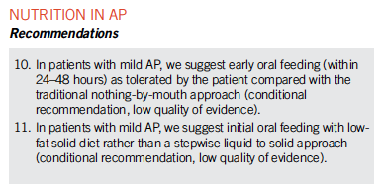
What’s the detail with enteral feeding?
Nutrition: Brief Summary
Parenteral nutrition should be avoided, unless the enteral route is not possible, not tolerated, or not meeting the caloric needs
Using a nasogastric rather than nasojejunal route for delivery of enteral feeding is preferred because of comparable safety and efficacy
Notes:
Enteral nutrition:
old teaching: avoid pancreatitic exocrine function, making ileus worse, etc. Gradually advance from clears -> liquids -> solids.
new teaching: enteral feeding maintains gut function Early = no significant nausea, vomiting, or ileus.
https://www.nejm.org/doi/full/10.1056/NEJMoa1404393 Python trial
The timing of initiating enteral feeding in patients with severe
disease is controversial. While studies initially suggested a benefit
in preventing infectious complications, more recent studies
suggest that early (within the first 24 hours) initiation of enteral
feeding is not beneficial. Bakker et al performed a large randomized
trial in patients with predicted severe AP (196) and
found that early enteral tube feeding within 24 hours did not
reduce the rate of infection (25% vs 26%) when compared with
on-demand feeding. In addition, early enteral tube feeding did
not reduce mortality (11% vs 7%).
However, our results show that routine
early tube feeding in all patients at high risk for
severe pancreatitis does not improve outcome
and that the implementation of on-demand tube
feeding will reduce patient discomfort and costs
no benefit in predicted severe AP
Describe 2 changes in how we think about enteral nutrition in pancreatitis.
(3: early in mild-moderate, no need to advance from clears-Liquids-solids, and use enteral, not parenteral nutrition when you can in severe AP
Enteral nutrition:
old teaching: avoid pancreatitic exocrine function, making ileus worse, etc. Gradually advance from clears -> liquids -> solids.
new teaching: enteral feeding maintains gut function Early = no significant nausea, vomiting, or ileus.

Slide 30
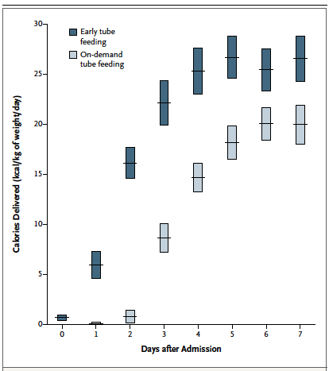
Python Trial, NEJM 2014
Early tube feeding (w/n 24h) vs On-Demand Tube Feeding (po 72h)
Predicted severe pancreatitis
13 centers, n=205
No difference in major infection (infected necrosis, bacteremia, pneumonia) or death to 6 months
69% of the on-demand group never required a feeding tube.
Notes:
https://www.nejm.org/doi/full/10.1056/NEJMoa1404393 Python trial
The timing of initiating enteral feeding in patients with severe
disease is controversial. While studies initially suggested a benefit
in preventing infectious complications, more recent studies
suggest that early (within the first 24 hours) initiation of enteral
feeding is not beneficial. Bakker et al performed a large randomized
trial in patients with predicted severe AP (196) and
found that early enteral tube feeding within 24 hours did not
reduce the rate of infection (25% vs 26%) when compared with
on-demand feeding. In addition, early enteral tube feeding did
not reduce mortality (11% vs 7%).
However, our results show that routine
early tube feeding in all patients at high risk for
severe pancreatitis does not improve outcome
and that the implementation of on-demand tube
feeding will reduce patient discomfort and costs

Slide 31
Bibliography/References
Trials:
WATERFALL TRIAL: N Engl J Med 2022
2. APEC Trial: Lancet 2020
3. POINTER Trial N Engl J Med 2020
4. PYTHON Trial N Engl J Med 2014
Guideline:
2024 ACG Guideline: DOI: 10.14309/ajg.0000000000002645
Notebook:

Slide 32
Questions? brian.locke@imail.org

